Slide 1
IRSOL Database
Author: Basili Michel

Slide 2
Introduction
Possibility to save the observations data with their measurements in a database.
Make management (adding, modifying, deleting or viewing) of the data possible for everyone according to their credentials.

Slide 3
Objectives
Creation of a .sql file for creating the database
Creation of a GUI for data visualisation (under development)
Creation of a REST API service to allow access to the data
Creation of a Python package to allow fast access to the database (Testing)
The whole structure must be modifiable easily and with as few changes as possible
Documentation

Slide 4
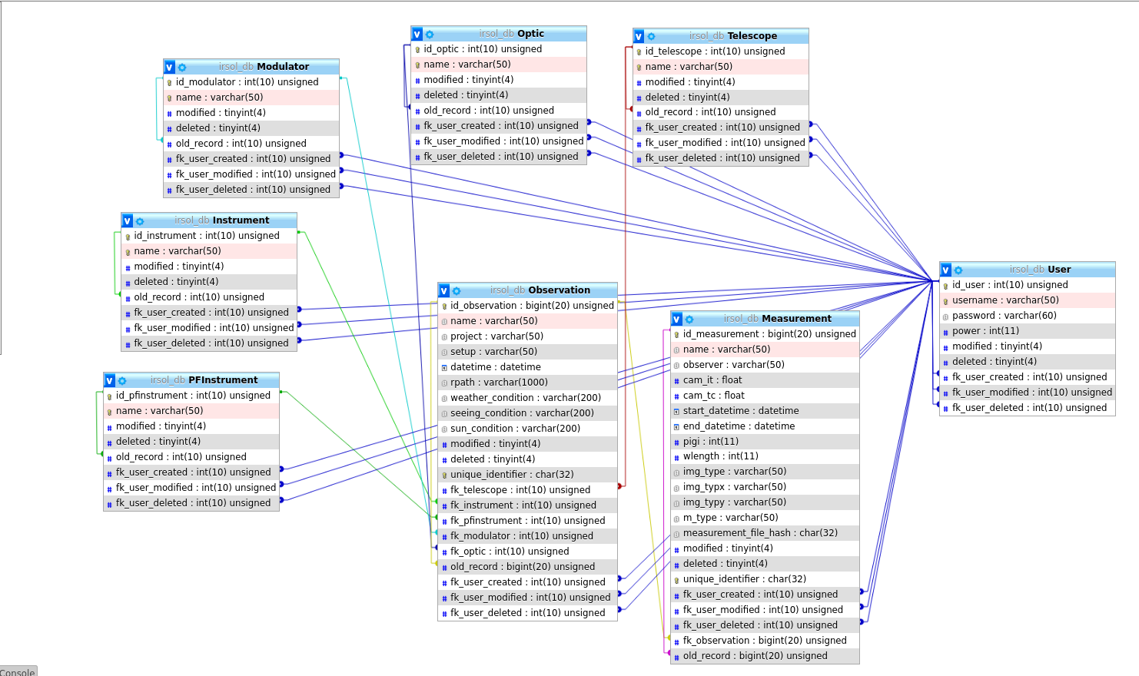
Server
The data are stored in a MySql database created from a .sql file.
The database can be modified using sql commands. Adding new tables requires updating the server structure, while adding fields does not require it.

Slide 5
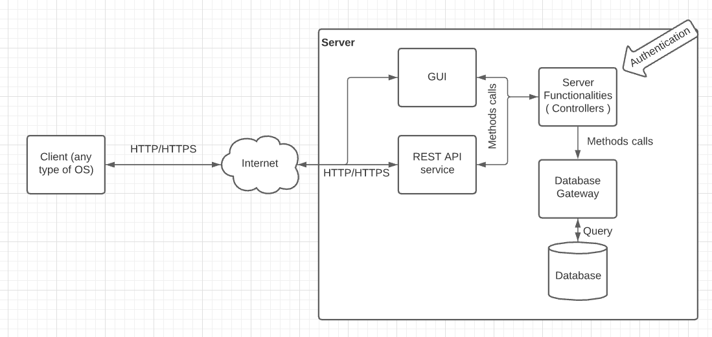
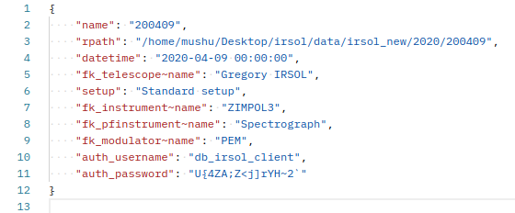
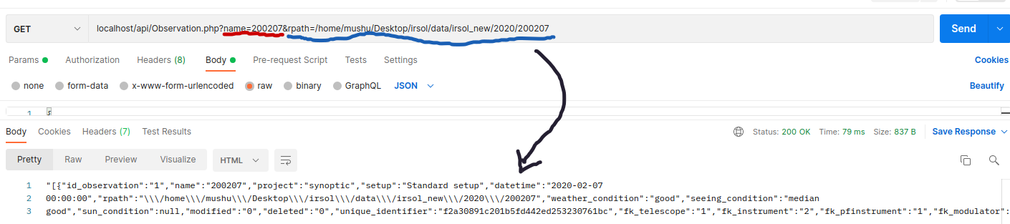
Server (REST API service)
A REST API service allows access to functionality provided by a machine via HTTP/HTTPS requests.
In this case, the functionality provided by the server, and therefore by the service, includes database management.
Data between a client and the REST API service are sent encoded using the JSON format.
Data security is guaranteed if the HTTPS protocol is used.

Slide 6
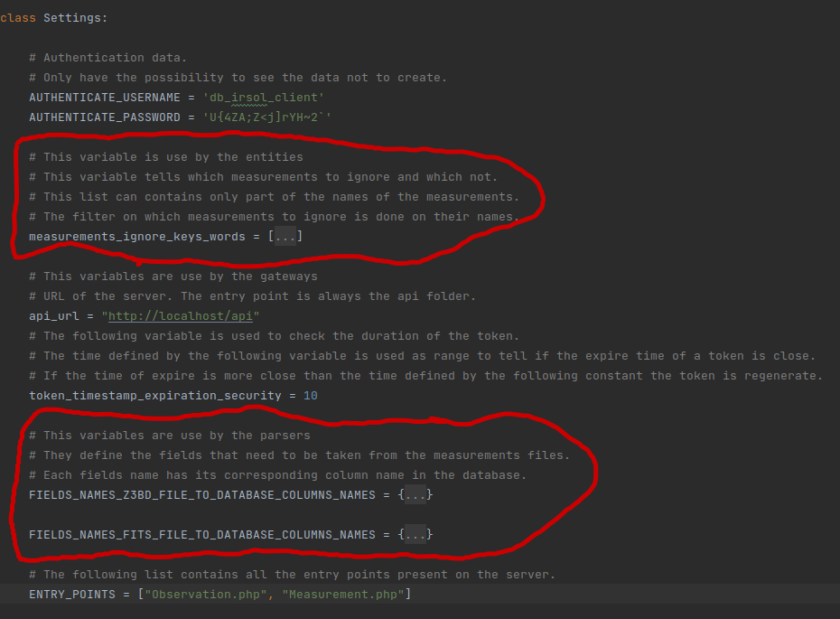
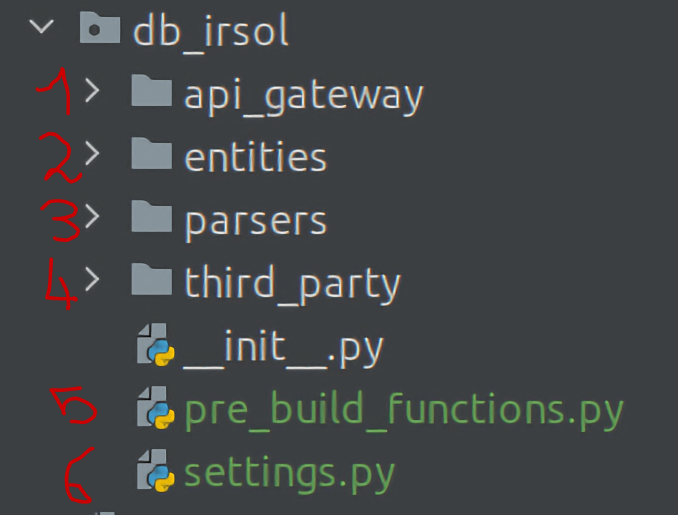
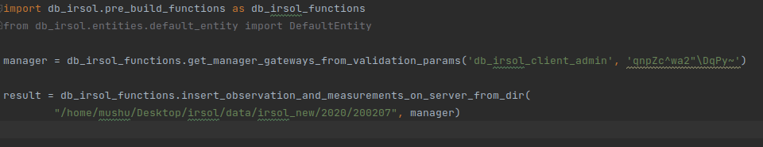
Python Package
The package will be uploaded on github for you to download. Once you have it, you can install it in your environment like any Python package.
The package is made up of 6 parts

